Slide 1

CE101 Engineering Drawing Lec8: Development of Surfaces
Indian Institute of Technology Guwahati
Notes:
Today we will discuss about the Modeling and

Slide 2
Outline
So far
Engineering Applications of the Principles of Projections of Solids.
Sections of Solids.
Now
Development.
Intersections
What is Development?
Why develop at all? - Applications
Methods of Development
Examples on development of various shapes

Slide 3
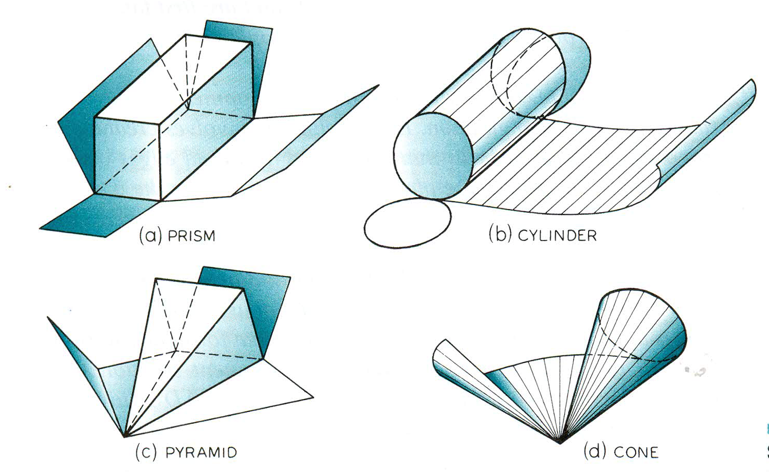
Development is a graphical method of obtaining the area of the surfaces of a solid. When a solid is opened out and its complete surface is laid on a plane, the surface of the solid is said to be developed.
Every line on the development should be true length of the corresponding line on the surface of the solid.

Slide 4
Development of lateral surfaces of different solids.
(Lateral surface is the surface excluding top & base)
Cylinder: A Rectangle
Pyramids: (No.of triangles)
Cone: (Sector of circle)
S
H
S
L
L
πD
D
H= Height D= base diameter
θ
Prisms: No.of Rectangles
R=Base circle radius.
L=Slant height.
L= Slant edge.
S = Edge of base
θ
=
R
+
L
360⁰
H
S
S
H= Height S = Edge of base
Cube: Six Squares.
Tetrahedron: Four Equilateral Triangles
All sides
equal in length

Slide 5
Importance of Surface Development

Slide 6
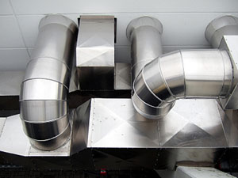
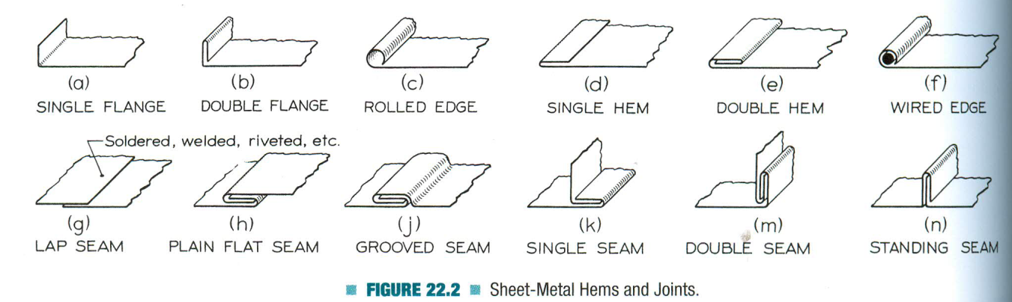
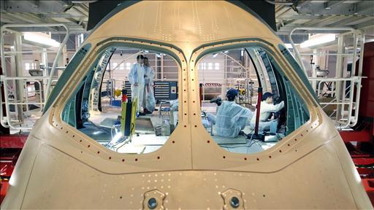
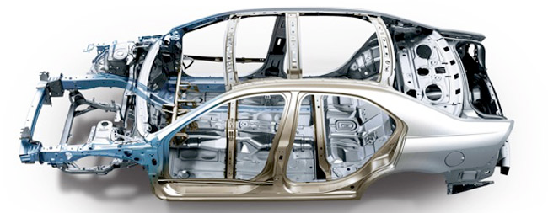
Importance of Surface Development – contd.
The knowledge of development of surfaces is essential in many industries such as automobile, aircraft, ship building, packaging and sheet metal work. In construction of boilers, bins, process vessels, hoppers, funnels, & chimneys, the plates are marked and cut according to the developments which when folded form the desired objects

Slide 7
Methods Used to Develop Surfaces
Parallel-line development: Used for prisms, and cylinders in which parallel lines are drawn along the surface and transferred to the development.
Radial-line development: Used for pyramids, and cones in which the true length of the slant edge or generator is used as radius.
Triangulation development: Complex shapes are divided into a number of triangles and transferred into the development (usually used for transition pieces).
Approximate method: Surface is divided into parts and developed. Used for surfaces such as spheres, paraboloids, ellipsoids etc.
Note:- The surface is preferably cut at the location where the edge will be smallest such that welding or other joining procedures will be minimal.

Slide 8
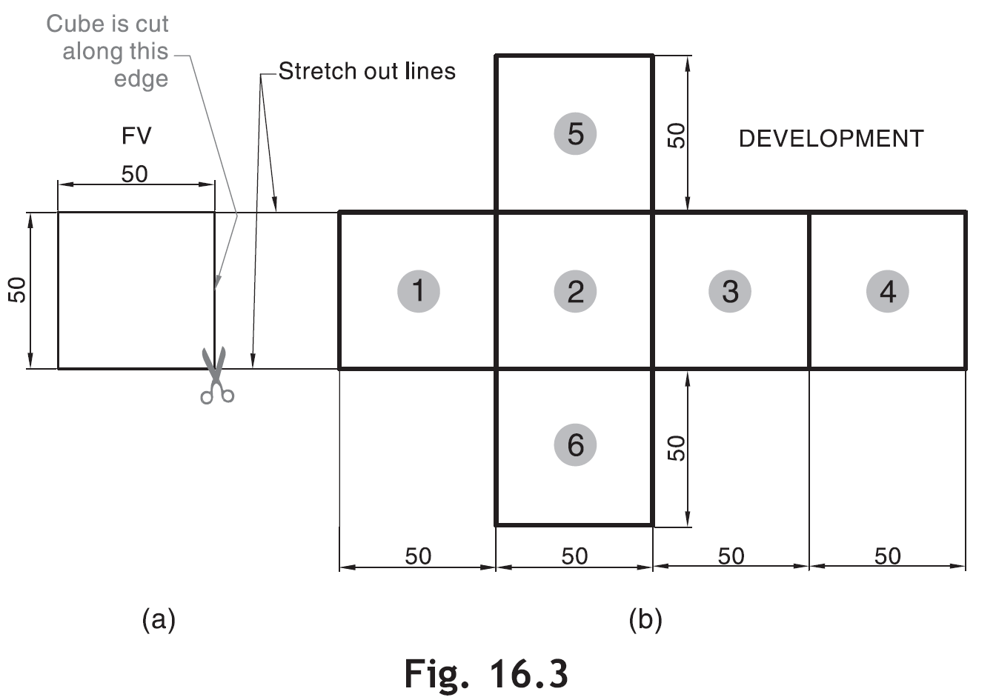
Parallel Line Development
This method is employed to develop the surfaces of prisms and cylinders. Two parallel lines (called stretch-out lines) are drawn from the two ends of the solids and the lateral faces are located between these lines.

Slide 9
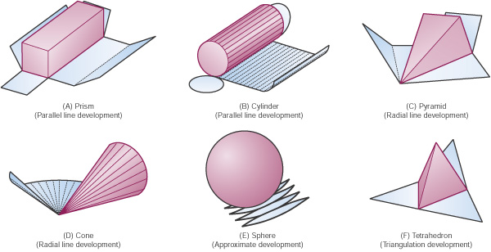
Development of Surface for Solids

Slide 10
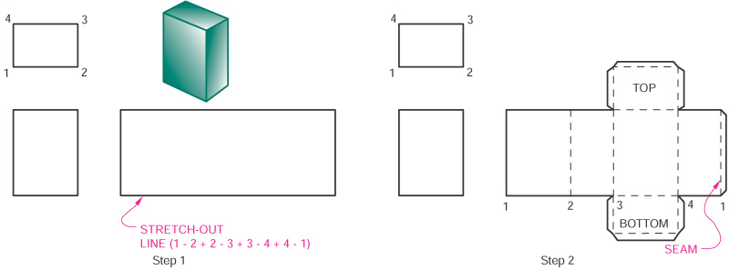
Development of a Right Rectangular Prism

Slide 11
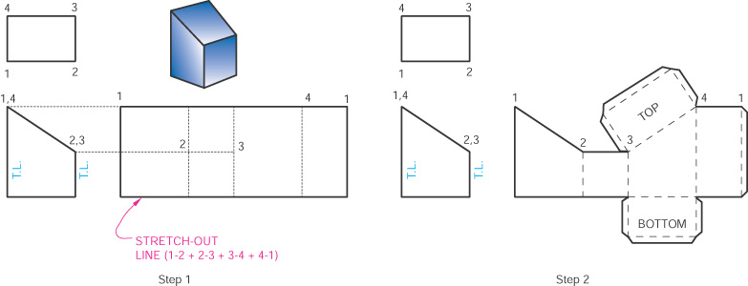
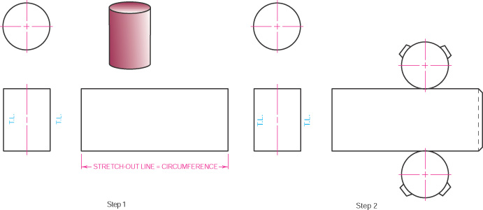
Truncated Prism / Cylinder

Slide 12
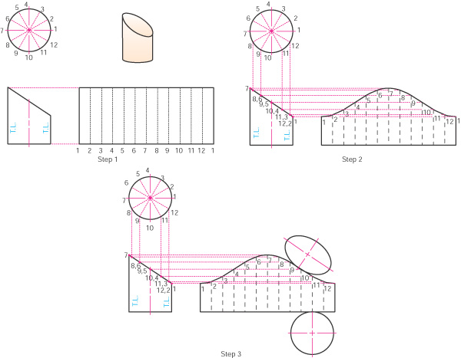
Truncated Cylinder

Slide 13
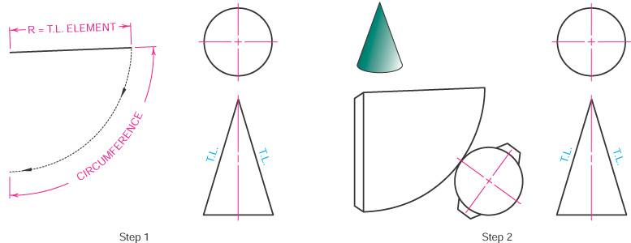
A Right Circular Cone

Slide 14
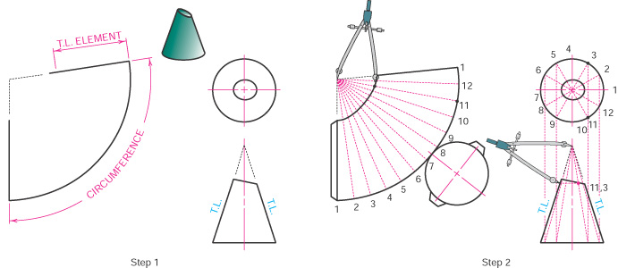
Truncated Right Circular Cone

Slide 15
Example Problems

Slide 16
Example 1
A hexagonal prism, edge of base 20 mm and axis 50 mm long, rests with its base on H.P. such that one of its rectangular faces is parallel to V.P. It is cut by a plane perpendicular to V.P., inclined at 45 degree to H.P. and passing through the right corned of the top face of the prism. Draw the sectional top view and develop the lateral surface of the truncated prism.
A’
B’F’
C’E’
D’
A’
B’
C’
D’
E’
F’
A’
4
4
3
3
5
5
50 mm
2
2
6
1
6
1
1
45⁰
X
Y
F
E
A
B
C
D
E
F
A
6
5
DEVELOPMENT
A
1
4
D
20 mm
SECTIONAL T.V
B
2
3
C
20 mm

Slide 17
Example 2
A cone of base 50 mm diameter and height 65 mm rests with its base on H.P. Its front elevation is cut by a plane at an angle of 30 degree to horizontal plane at a distance of 30 mm above the base. Draw the development of the lateral surface of the truncated cone.
A
SECTIONAL S.V
B
o’
SECTION
PLANE
4
5
8
7
1
C
3
6
DEVELOPMENT
1
2
L
1
5
2
65 MM
30◦
D
2
3
4
3
4
30 MM
5
E
X
a’
h’
b’
c’
g’
f’
d’
e’
Y
6
g” h”f” a”e” b”d” c”
7
F
g
8
h
7
f
L
1
G
8
6
=
R
θ
+
H
a
1
5
L
360⁰
e
2
4
A
SECTIONAL T.V
3
b
d
c
50 MM

Slide 18
Frustums – Development of Surfaces
DEVELOPMENT OF
FRUSTUM OF CONE
DEVELOPMENT OF
FRUSTUM OF SQUARE PYRAMID
Base side
Top side
L
L
L₁
L₁
θ
θ
=
R
+
L
360⁰
R= Base circle radius of cone
L= Slant height of cone
L₁ = Slant height of cut part.
L= Slant edge of pyramid
L₁ = Slant edge of cut part.

Slide 19
Problem 1: A pentagonal prism, 30 mm base side & 50 mm axis
is standing on HP on it’s base whose one side is perpendicular to VP.
It is cut by a section plane 45⁰ inclined to Hp, through mid point of axis.
Draw FV, sec.TV & Sec. Side view. Also draw true shape of section and
Development of surface of remaining solid.
Solution Steps: for sectional views:
Draw three views of standing prism.
Locate sec.plane in FV as described.
Project points where edges are getting cut on TV& SV as shown in illustration.
Join those points in sequence and show section lines in it.
Make remaining part of solid dark.
C
TRUE SHAPE
B
D
Y₁
A
E
A
B
C
D
E
A
d”
c”
X₁
a’ b’ e’ c’ d’
b”
e”
X
a”
Y
e
DEVELOPMENT
d
a
For Development:
Draw development of entire solid.
Name from cut-open edge i.e. A in sequence as shown.
Mark the cut points on respective edges.
Join them in sequence in st. lines.
Make existing parts dev. dark.
c
b
For True Shape:
Draw X₁Y₁ // to sec. plane
Draw projectors on it from cut points.
Mark distances of points of sectioned part from Tv, on above projectors from X₁Y₁ and join in sequence.
Draw section lines in it.
It is required true shape.

Slide 20
Problem 2: A cone, 50 mm base diameter and 70 mm axis is
standing on it’s base on HP. It cut by a section plane 45⁰ inclined
to HP through base end of end generator. Draw projections,
sectional views, true shape of section and development of surfaces
of remaining solid.
Solution Steps: for sectional views:
Draw three views of standing cone.
Locate sec.plane in FV as described.
Project points where generators are getting cut on TV & SV as shown in illustration.
Join those points in sequence and show section lines in it.
Make remaining part of solid dark.
TRUE SHAPE OF SECTION
Y₁
A
SECTIONAL S.V
o’
SECTION
PLANE
B
DEVELOPMENT
C
D
X₁
E
X
a’
h’
b’
c’
g’
f’
d’
e’
g” h”f” a”e” b”d” c”
Y
F
For True Shape:
Draw X₁Y₁ // to sec. plane
Draw projectors on it from cut points.
Mark distances of points of sectioned part from TV, on above projectors from X₁Y₁ and join in sequence.
Draw section lines in it.
It is required true shape.
g
h
f
G
For Development:
Draw development of entire solid.
Name from cut-open edge i.e. A. in sequence as shown.
Mark the cut points on respective edges.
Join them in sequence in curvature.
Make existing parts dev. dark.
a
H
e
A
b
d
c
SECTIONAL T.V

Slide 21
Problem 3: A cone 40mm diameter and 50 mm axis is resting on one generator on HP( lying on HP) which is parallel to VP.. Draw it’s projections. It is cut by a horizontal section plane through it’s base center. Draw sectional TV, development of the surface of the remaining part of cone.
Follow similar solution steps for Sec. views - True shape – Development as per previous problem!
o’
DEVELOPMENT
A
B
HORIZONTAL
SECTION PLANE
a’
h’b’
c’g’
d’f’
e’
C
D
X
a’
h’
Y
b’
c’
g’
f’
d’
e’
o’
g
g₁
O
E
h
f
f₁
h₁
F
a
O
e
e₁
a₁
o₁
G
H
b
d
d₁
b₁
c
A
c₁
SECTIONAL T.V
(SHOWING TRUE SHAPE OF SECTION)

Slide 22
Note the steps to locate
Points 1, 2 , 5, 6 in sec.FV:
Those are transferred to
1st TV, then to 1st FV and
Then on 2nd FV.
Problem 4: A hexagonal prism. 30 mm base side &
55 mm axis is lying on HP on it’s rect.face with axis
parallel to VP. It is cut by a section plane normal to Hp and 30⁰ inclined to Vp bisecting axis.
Draw sec. Views, true shape & development.
a’
b’
c’
f’
d’
e’
3
SECTIONAL F.V.
Use similar steps for sec.views & true shape.
NOTE:
For development, always cut open object from an edge in the boundary of the view in which sec.plane appears as a line.
Here it is TV and in boundary, there is c1 edge. Hence it is opened from c and named C,D,E,F,A,B,C.
4
2
5
a’
b’
c’
f’
d’
e’
X
1
6
Y
f
8
7
f₁
e₁
a
e
a₁
1,2 3,8 4,7 5,6
A.V.P30⁰ inclined to Vp
Through mid-point of axis.
d₁
b
d
b₁
AS SECTION PLANE IS IN T.V.,
CUT OPEN FROM BOUNDRY EDGE C₁ FOR DEVELOPMENT.
c
X₁
c₁
8
7
C
D
E
F
A
B
C
1
6
Y₁
2
5
TRUE SHAPE OF SECTION
4
3
DEVELOPMENT

Slide 24
Advanced problems

Slide 25
Problem 5: A solid composed of a half-cone and half- hexagonal pyramid is
shown in figure. It is cut by a section plane 45⁰ inclined to HP, passing through
mid-point of axis. Draw FV, sectional TV, true shape of section and
development of remaining part of the solid.
( take radius of cone and each side of hexagon 30mm long and axis 70mm.)
TRUE SHAPE
3
2
4
5
Y₁
1
Note:
FV & TV of two solids
sandwiched
Section lines style in both:
Development of
half cone & half pyramid:
O’
6
A
7
DEVELOPMENT
B
4’
3’
C
X₁
5’
F.V.
2’
6’
4
3
2
1’
1
D
7’
X
Y
d’e’
c’f’
g’b’
a’
O
f
E
6
g
7
e
5
SECTIONAL
TOP VIEW.
7
4
5
6
4
a
F
1
3
d
2
b
G
06-10-2023
c
Development of Surfaces
25
A

Slide 26
Problem 6: Draw a semicircle 0f 100 mm diameter and inscribe in it a largest
circle. If the semicircle is development of a cone and inscribed circle is some
curve on it, then draw the projections of cone showing that curve.
TO DRAW PRINCIPAL
VIEWS FROM GIVEN
DEVELOPMENT.
E
R = Base circle radius.
L = Slant height.
D
4
F
o’
3
5
θ
=
R
+
C
G
L
360⁰
L
1’
2
6
7’
B
H
6’
2’
1
θ
7
5’
X
a’
h’
b’
c’
g’
3’
4’
d’f’ e’
Y
A
A
O
g
L
h
6
f
Solution Steps:
Draw semicircle of given diameter, divide it in 8 Parts and inscribe in it a largest circle as shown.
Name intersecting points 1, 2, 3 etc.
Semicircle being dev. of a cone it’s radius is slant height of cone.( L )
Then using above formula find R of base of cone.
Using this data draw FV & TV of cone and form 8 generators and name.
Take o -1 distance from dev.,mark on TL i.e. o’a’ on FV & bring on o’b’ and name 1’
Similarly locate all points on FV.
Then project all on TV on respective generators and join by smooth curve.
5
a
7
o
4
e
1
b
3
d
2
c

Slide 27
Problem 9: A particle which is initially on base circle of a cone, standing
on HP, moves upwards and reaches apex in one complete turn around the cone.
Draw it’s path on projections of cone as well as on it’s development.
Take base circle diameter 50 mm and axis 70 mm long.
It’s a construction of curve
Helix of one turn on cone:
Draw FV & TV & dev.as usual on all form generators & name.
Construction of curve Helix::
Show 8 generators on both views
Divide axis also in same parts.
Draw horizontal lines from those points on both end generators.
1’ is a point where first horizontal line & gen. b’o’ intersect.
2’ is a point where second horiz. line & gen. c’o’ intersect.
In this way locate all points on FV.
Project all on TV.
Join in curvature.
For Development:
Then taking each points true distance from resp. generator from apex, mark on development & join.
o’
7’
DEVELOPMENT
HELIX CURVE
6’
A
5’
4’
B
3’
2’
1
1’
C
X
Y
2
a’
h’
D
b’
c’
g’
f’
d’
e’
g
3
h
f
O
4
E
7
6
5
6
5
a
7
e
F
O
4
3
G
b
1
2
d
c
H
A

Slide 28

Thank You for Patient Hearing

